Slide 1

KARACHI AQI PREDICTOR
A Serverless Machine Learning System for Urban Air Quality Forecasting
Designed & Developed By Hamza Ali Khan

Slide 2

What is this Project?
This project is an end-to-end, serverless ML system that forecasts Karachi's AQI for 24h, 48h, and 72h horizons.
•
Data Source: Open-Meteo (Weather + Pollutants).
•
Infrastructure: BigQuery (Feature Store) & GCS (Model Registry).
•
Training Data: We have 2400+ rows of data, but we are training models on the last 92 days to account for seasonal fluctuations and shifts in Karachi's weather.

Slide 3






Overall Project Structure
Pipelines
GCP Layer
Dashboard
Two main workflows: Feature engineering (fetching/processing data to BQ) and Training models (saving to GCS), plus utility/backfill scripts.
BigQuery acts as the central feature store, and Google Cloud Storage handles the model registry for the 24h, 48h, and 72h horizons.
A Streamlit application deployed to the cloud providing real-time forecasts, model comparisons, and EDA visualizations.

Slide 4
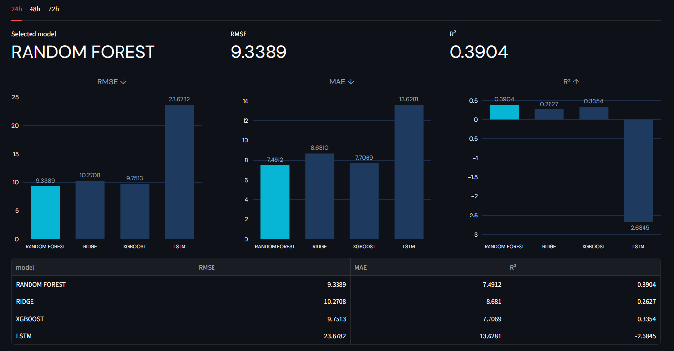
Model Training Journey
We experimented with multiple algorithms to find the most honest forecasting performance, avoiding the trap of 'nowcasting'.
•
Models Tested: Ridge, Random Forest, XGBoost, and LSTM.
•
Selection: Random Forest was chosen as the best model across all horizons after rigorous comparison.
•
Final Strategy: Three separate models per horizon (24h, 48h, 72h) rather than one multi-output model for cleaner tracking.

Slide 5
Key Challenges Overcome
Distribution Shift
Synthetic backfill data had drastically different AQI means compared to real recorded data. We rebuilt the feature group using strictly clean data from January 2026 onwards.
Feature Leakage
Initial metrics looked suspiciously perfect (R² ~0.92) because PM2.5 forecasting features acted as a direct proxy for target AQI. We removed these columns for honest forecasting.
Infrastructure Limits & Time Gaps
Faced a major roadblock with a 19-day 'zombie' materialization job on Hopsworks, prompting a migration to BigQuery & GCS for guaranteed stability. Also fixed timestamp gaps corrupting shift-based targets.

Slide 6
LET'S MOVE TO THE DASHBOARD
Live demonstration of the Karachi AQI Predictor

